Slide 1
CS 4530: Fundamentals of Software Engineering Module 10: Testing Larger Things
Adeel Bhutta, Rob Simmons, and Mitch Wand
Khoury College of Computer Sciences
© 2026 Released under the CC BY-SA license

Slide 2
Learning Objectives for this Lesson
By the end of this lesson, you should be prepared to:
Explain why you might need a test double in your testing
Design test cases for code using fakes, mocks and spies
Explain why you might need tests that are larger than unit tests
Explain how large, deployed systems lead to additional testing challenges

Slide 3
Why do we test?
Unit Testing
Does the SUT satisfy its specification?
Integration Testing
Do the SUT and its context work correctly together?
Acceptance Testing
Does the SUT satisfy the customer
“Good” test suite answers: Are we building the right system ?
Notes:
<read slide> . We'll talk about all three of these today.

Slide 4
The Story So Far: Testing Things That Look Like Functions
Unit tests are tests of functions with no dependencies
REST API tests are integration tests, but have the same basic shape
test('addStudent should add a student to the database', () => {
expect(db.nameToIDs('blair')).toEqual([])
const id1 = db.addStudent('blair');
expect(db.nameToIDs('blair')).toEqual([id1])
});
test('GET /api/user/:id should 404 for if no user', async () => {
response = await supertest(app).get(`/api/user/nobody`);
expect(response.status).toBe(404);
expect(response.body).toStrictEqual({ error: 'No user' });
});
Notes:
So far, we’ve examined unit tests, where we’re testing

Slide 5
Why Does The “Story So Far” Stop Working?
Integration tests become too big and complicated, with many dependencies
Test doubles can replace dependencies to isolate the function
Tests stop looking like functions (or we need to test non-function-like properties of the functions, like their effects)
Test doubles can track the changes to the environment in a way that we can double check from within our code.
UI tests don’t look like functions; UI testing frameworks like Playwright are a bit different.
Notes:
Ask: why isn’t the story so far good enough?
There’s lots of reasons: UI tests don’t fit the pattern, it’s too slow to do things this way, etc. I think they can largely be shoehorned into: all the dependencies are too many, and some tests aren’t input-output tests.
<click, reveal the two categories. Discuss how student answers do or don’t fit into these!>
<click, reveal subheadings>
The main topic we’re going to talk about today is how test doubles allow us to solve this problem.

Slide 6
Test doubles replace uncontrollable things with things that you do control
The SUT
(System
Under
Test)
Network
Resources
Mo
Human User
Database
Notes:
The system under test can have all sorts of dependencies — humans users, databases, network libraries, other parts of the same application. We want to use test doubles to replace these dependencies in testing.
Let’s look at what this looks like in the context of the GameNite application you’ve already been working with.

Slide 7

Test doubles replace uncontrollable things with things that you do control
Vitest service layer tests
GameNite service and repository layers
Use“fresh” in-memory database for each test
GameNite controller layer
In-Memory Database
MongoDB Database
Notes:
In GameNite, some of the tests are tests of the service layer. The service layer is only called by the controller layer and is the only thing that calls the repository layer, and the repository layer is the only thing that calls the database and “knows” that we’re using a mongodb database backend.
(click)
When we test the service layer, we want our tests to replace the controller layer (and have vitest poke the service layer directly). We also want to avoid connecting to our main MongoDB database, for a couple of reasons. (Ask: why? Potential answers: it’s harder/slower/more annoying to reset the mongodb database, we want to do things to our database that would be irresponsible or unfortunate to do in a real website.)
(click)
The application is set up to use an in-memory database in a testing environment [well actually: it’s set up to use an in-memory database by default, and running the app from `server/src/server.ts` overrides that default]. This in-memory database is our first clear example of a test-double: it’s a real Keyv implementation, it works in all the same ways, but we wouldn’t want to use it for our real application (because a power outage would wipe our whole history).

Slide 8
“Test Doubles” Stand In For Other Components
Act as a stand-in for components, allowing for testing in isolation
Fakes: Replace “real” implementation with some simplified, but at-least-sort-of-working, version for testing
Mocks: Automatically-generated fake implementations for an interface
Spies: Automatically-instrument internals of objects, classes or modules
Notes:
We’ll split test doubles into different categories, but you should be aware that these terms are often used quite loosely, and different testing frameworks assert different opinions on what to call these things. In particular, as we’ll see, there is a lot of similarity between a spy and a mock.
An implementation that is impractical for some reason but works great for testing is a “fake” — as Martin Fowler defines these terms, an in-memory database is pretty much the canonical example of a fake.

Slide 9
“Test Doubles” Stand In For Other Components
Act as a stand-in for components, allowing for testing in isolation
Fakes: Replace “real” implementation with some simplified, but at-least-sort-of-working, version for testing
Mocks: Automatically-generated fake implementations for an interface
Spies: Automatically-instrument internals of objects, classes or modules
How do we test this function? What do we even want to test?
/** Returns true half the time, o/w false */
function coinFlip() {
return Math.random() >= 0.5;
}
Notes:
Mocks and spies are related ways of isolating a system under test from its dependencies. To talk about these and the differences between them, let’s think about what it would mean to test this function. What should we do to test a function like this?

Slide 10
“Test Doubles” Stand In For Other Components
Aside: Test Oracles
To assess a function, you need to know what it ought to do!
Function returns the exact “right” answer
Function returns an acceptable answer
Returns the same value as last time
Function returns without crashing
Function crashes (as expected)
Function has the right effects on its environment
Act as a stand-in for components, allowing for testing in isolation
Fakes: Replace “real” implementation with some simplified, but at-least-sort-of-working, version for testing
Mocks: Automatically-generated fake implementations for an interface
Spies: Automatically-instrument internals of objects, classes or modules
Snapshot testing is a version of this
Mocks/spies are very good here
How do we test this function? What do we even want to test?
/** Returns true half the time, o/w false */
function coinFlip() {
return Math.random() >= 0.5;
}
Notes:
A tangent before we proceed: one reason this function is hard to test is because it has an unpredictable dependency, but the other reason this function is hard to test is: how do we even do the “Assess” part of the Assemble-Act-Assess test pattern?
The tests you’ve usually written are the first two categories, with maybe a little bit of the fourth or fifth.
Sometimes, fakes are used just as oracles: you might use your slow Fibonacci function as an oracle to check the work of your fast but confusing Fibonacci calculation function.
(click)
Sometimes, when we run our test the first time, we kind of assume the answer looked right and just want to make sure the answer doesn’t change in the future. You’ll almost certainly do this sometimes with vitest, where you just start with a function that returns something complicated, say that you expect it returns null, then run vitest to see what it actually got, then paste that in as what you expect it to return.
This is a very common pattern, and tools like Vitest and especially frontend testing tools like Playwright include facilities for doing this more automatically. We’ll come back to this
(click)
Mocks and spies are good at expressing this kind of expected behavior.

Slide 11
Spies Instrument Dependencies
/** Returns true half the time, otherwise false */
function coinFlip() {
return Math.random() >= 0.5;
}
test('coinFlip should call Math.random', () => {
const spyRandom = vi.spyOn(Math, 'random');
coinFlip();
expect(spyRandom).toHaveBeenCalled(); expect(spyRandom).toHaveBeenCalledTimes(1);
});
Notes:
This use of `vi.spyOn` replaces `Math.random` with a new version of itself. A spy test double that remembers how it was called, what arguments it gave, and how it returned. This lets us check that the coinflip actually called Math.random, which may be something that we’d like to check!
The spy is just a silent watcher, watching everything that comes through and recording it.
But let’s put our adversarial testing hats on: how could we mutate this coinflip function such that it doesn’t remotely do what we’re expecting it to, but still passes this test? (Hopeful answer: well, it could call Math.random, throw away the result, and then return true, or false.)

Slide 12
Spied-On Functions Can Be Mocked, Changing Their Implementation
/** Returns true half the time, otherwise false */
function coinFlip() {
return Math.random() >= 0.5;
}
test('coinFlip notices Math.random’s output', () => {
const spyRandom = vi.spyOn(Math, 'random');
spyRandom.mockImplementationOnce(() => 0.9);
expect(coinFlip()).toBe(true);
spyRandom.mockImplementationOnce(() => 0.1);
expect(coinFlip()).toBe(false);
});
Notes:
If we want to at least check that coinflip is actually using Math.random in some way to generate the result, we can tell our spy “hey, next time you’re called, don’t call the real Math.random at all! Instead, return this specific value I’m giving you”
Now that have taken control over Math.random, we can tell it what to return, and notice that coinflip returns different values for when Math.random returns different values.
It’s obviously still possible to imagine an evil mutant of coinflip: can you think of some examples? (A biased coin is an obvious answer.) But this is at least working to ensure there is some randomness in the coin flip.

Slide 13
Spies Can be Used Even When You Can’t (Fully) Control the SUT
You can specify any object, and any method name (even private methods)
Spy on objects or entire modules
The spy logs all calls to that method of that object or module
The call to the original still gets made, unless the spy explicitly supplies a substitute mock
Notes:
<read slide>
The spy example from clocks shows putting a spy on a single object. However, we can also use spies on entire modules, for example, spying on calls to a method exported by a module, like the “log” method of “console”. Since spies intercept ALL calls to the target method, this means that we can spy on a global method (like console.log) in our test, and intercept calls to that method deep within the system under test.

Slide 14
Overspecification is Very Easy With Spies
/** Returns true half the time, otherwise false */
function coinFlip() {
return Math.random() >= 0.5;
}
Do we actually care that coinflip is getting its randomness from Math.random?
Do we actually care which Math.random values lead to true and which to false?
Notes:
A problem with this approach to spying is that it’s very easy to write tests that assume way too much about their implementation. This can make dealing with tests a pain. Math.random isn’t a part of the interface of coinFlip, so we’re testing something that’s very specific about the implementation.

Slide 15
Dependency Injection is Passing The Dependencies as Function Arguments
/**
* @param randomSource - randomness source
* @returns true if randomSource returns >= 0.5
*/
function coinFlip2(randomSource: () => number) {
return randomSource() >= 0.5;
}
test('coinFlip2 uses the randomness source', () => {
expect(coinFlip2(() => 0.9)).toBe(true); expect(coinFlip2(() => 0.1)).toBe(false);
});
Notes:
Some folks advocate for the strategy of “dependency injection” to write more testable code — if we might need to modify the behavior of Math.random for testing, then let’s make it an input to coinFlip instead of just having it be an implicit dependency we manipulate with spies.
The cost is the interface is quite a bit more complicated.
(click)
This solves the overspecification problem — the way the function uses randomness is now in the spec and much more fair game for testing.
On the other hand, testing becomes straightforward, because we’re not trying to swap out the randomness source from underneath the function — we’re just passing the function different arguments.
This is a very simple example for the sake of fitting on a slide, but dependency injection can make sense in larger programs — the gamenite controller layer passes the websocket dependencies in as function arguments in the style of dependency injection.

Slide 16
Simple Mocks
Vitest mocks return “undefined” by default (can be customized), and also spies on all the calls to the function
test('a simple mock', () => {
const myMock = vi.fn();
expect(myMock(104)).toBeUndefined();
expect(myMock('Hello', 'you')).toBeUndefined();
expect(myMock.mock.calls).toEqual([
[104],
['Hello', 'you'],
]);
});
Notes:
When dealing with dependency injection-like patterns, it can be helpful to create spying mocks from the “ground up,” rather than from spying on existing code. The vi.fn function does this, and can be configured in a number of ways. (The resources for this lecture include a Vitest cheat sheet.)

Slide 17
Another Example of Spies
function sayHello(name: string) {
console.log(`Hello, ${name}`);
}
test('sayHello prints a greeting', () => {
const spyLog = vi.spyOn(console, 'log');
spyLog.mockImplementation(() => {})
sayHello('CS4530');
expect(spyLog.mock.calls).toEqual([['Hello, CS4530']]);
});

Slide 18

Mocks vs Spies
The SUT
(System
Under
Test)
spy
Dependency
Mo
the mock is spying
Mock
Implementation
Dependency
Notes:
Spying and mocking are different ways of dealing with dependencies.
(click, reveal spy)
Spying creates a test double that basically wraps the existing dependency and keeps it in place — it just watches the traffic between the SUT and its dependency. It’s not particularly disruptive.
But if your dependency is doing something slow (database operations), complicated (discovering the prime factors of a large composite number), possibly dangerous (making stock trades), or unpredictable (Math.random), then just watching won’t let you test your SUT reliably.
(click, revealing mock)
Vitest’s spying infrastructure also lets you create a mock implementation — a mock is another kind of fake, usually a really really simple one.

Slide 19
Integration Testing
Notes:
Sometimes, we don’t want to replace aspects of the system under test, but we want to test all the components and their interactions. That’s where we get into integration testing

Slide 20
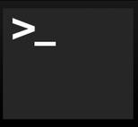

But some bugs are observable only when multiple components interact.
These are usually because one module has made incorrect assumptions about some other module
Unit tests won’t reveal such bugs
Mocks won’t help, either (since they may incorporate our incorrect assumptions)
So you really need integration tests
Integration
Unit
Mork
1 program running on 1 server
1 class of 1 program running on 1 server
Notes:
So far, our focus has been on writing on unit tests, which focus on a single module or class.
Many bugs may be observable only when multiple components interact (often as a result of one making an incorrect assumption about the others’ behavior).
To find these bugs, we may need to create bigger tests. These are generally called integration tests.

Slide 21

Integration tests may be larger, even enormous
Does the presence of other jobs on our server change the behavior of our program?
Does the presence of the other servers change the behavior of our program?
Integration
Unit
Mork
1 web server in a cluster of 100,000 servers
1 program running on 1 server
1 class of 1 program running on 1 server
Integration
Unit
Mork
1 class of one program running on a web server
1 Google product in the entire Google ecosystem
1 web server in a cluster of 100,000
1 process running on a web server
Notes:
For instance, our SUT might actually consist of multiple processes running in coordination on a single server.
Or maybe we need to worry about what happens when we run it on a live server, running alongside other servers in a cluster of 100’s of thousands of servers.
Or, maybe our focus is on testing the end-to-end behavior of an entire product, which is composed of many classes running in many processes on many servers. As you can see, the scope of integration tests can grow enormously.
Writing good end-to-end tests can be much more complex than writing unit or integration-level tests, because they need to set up much more state and interact with more external systems than a unit or integration test.
You can consider writing integration tests using Jest.

Slide 22
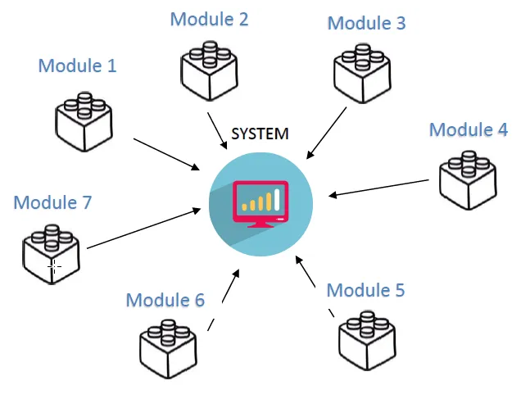
Integration tests can be done in many ways
All at once ("Big Bang")
Top-down
Bottom-up
Middle-out
Top-Bottom-Middle
etc., etc., etc.
Notes:
Big Bang Integration Testing: In this approach, almost all of the units or major units are combined together to perform integration testing in one attempt. Usually, this method is practiced when teams have entire software in their bundle.
Incremental Testing: In this testing approach, a minimum of two modules that are logically related is tested. Then, the related modules are summed up to perform testing and achieve proper functioning.
Top-down Integration Testing: In this testing approach, the teams test the top-level units first and then perform step-by-step testing of lower-level units.
Bottom-up Integration Testing: In this testing approach, the testing starts from the lower units of the application and then gradually moves up, i.e. the testing is practiced from the bottom of the control parts.
Hybrid/Sandwich Integration Testing: This approach is also known as hybrid integration as it is a combination based on bottom-up and top-down approaches. This approach overcomes many other limitations and helps to achieve the benefits of both the approaches

Slide 23
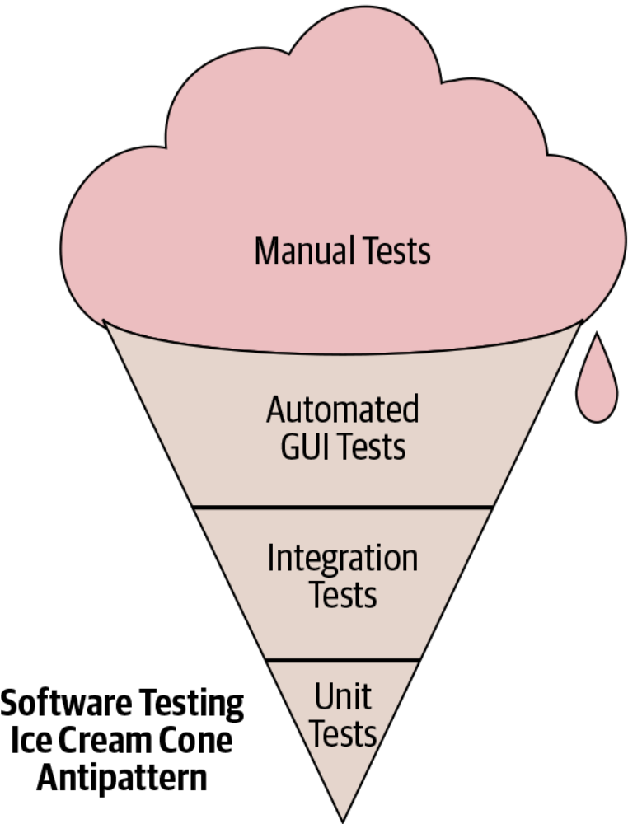
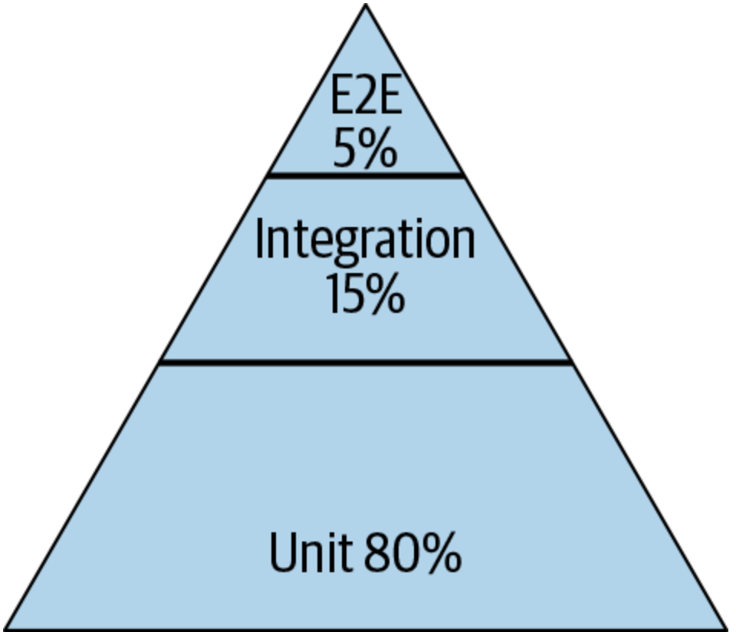
Testing Distribution (How much of each kind of testing we should do?)
Pyramid
Test Pattern
From SoftEng @ Google Chapter 11
https://learning.oreilly.com/library/view/software-engineering-at/9781492082781/ch11.html#testing_overview
Notes:
Typically we talk about this ice cream cone where we have a lot of a lot of manual tests, and then some automatic automated tests specifically related to GUI and then some integration tests and unit tests. The book that we mentioned earlier, software engineering at Google, recommends a different paradigm. It recommends that about 80% of your testing should be focused on unit testing and then about 15% on integration testing and then about 5% on end to end testing (what is known as system level testing).

Slide 24
How big is my test? Google’s Classification
Small: run in a single thread, can’t sleep, perform I/O or make blocking calls
Medium: run on single computer, can use processes/threads, perform I/O, but only contact localhost
Large: Everything else
"Software Engineering at Google: Lessons Learned from Programming Over Time," Wright, Winters and Manshreck, 2020 (O’Reilly)
Notes:
The lens that we will use to discuss testing strategies for large systems is "test size," a strategy used within Google: classify tests into a size and encourage engineers to always write the smallest possible test for a given piece of functionality. Test size is based on what it is allowed to do, and how many resources it consumes.
small tests run in a single process, medium tests run on a single machine, and large tests run wherever they want.
Small tests are structured to be fastest, most reliable. This becomes important if you want to run your tests a lot, like if you have ten thousand developers running tests 24/7. Similar to traditional unit testing.
Medium can do lots of stuff, but note importance of not connecting to other servers. This is so your entire test is self contained.
Large is everything else. These can be slowest to run and most fragile. Imagine you are testing connecting to a remote server, and sometimes it’s slow, or the canonical distributed systems example of an intern tripping over a cable. So, speaking of fragile.

Slide 25
Integration Tests can be Flaky
Flaky test failures are false alarms
Most common cause of flaky test failures: “async wait” - tests that expect some asynchronous action to occur within a timeout
UI Testing is often flaky and slower
Good tests avoid relying on timing
Good tests avoid relying on the order in which the tests are run
[Luo et al, FSE 2014 “An empirical analysis of flaky tests”]
Notes:
Once tests get to be any bigger than “small”, they may become flaky. UI Testing is often flaky and slower than unit testing
<read slide>

Slide 26
Flaky Test Example: Async/Wait
Most common root cause of flakiness
Difficult to avoid, but there are mitigations:
Have more “small” tests that don’t require concurrency
Ensure sufficient resources available for running tests
Embed reasonable error detection to classify test failures as likely to be “flaky” vs true failures
Start Test
Start server
Wait 3 seconds for server to start
Make request to server
Test fails!
Server startup complete
Too late!
Notes:
The diagram on the right here shows an example of the most typical kind of flaky test, one that is flaky due to an async wait problem.
In this example, a test starts up a server. The server starts up asynchronously. The test waits 3 seconds, assuming that after 3 seconds, the server will have started, and it then makes requests to the server, assuming that it started. However, if the server is late to start, taking MORE than three seconds, then when the test makes its requests to the server, the test will fail – because the server hasn’t started yet.
This is a difficult problem to avoid in general – perhaps the best fix is to write more unit tests (“small” tests that don’t make network connections), avoiding the problem altogether.
Of course, it is impossible to entirely design around this kind of test, because ultimately we need to test the integration of the components. When you have tests that depend on asynchronous things happening within some time bound, it is important to ensure that there are sufficient CPU and RAM available for running the test. This is because timing-dependent tests (like this one) can be more likely to fail due to flakiness when they are starved for resources (and stuff goes slower)
You might also embed reasonable error detection to make it easier to diagnose failures of this test. For example, you might consider making this test check that the server has started BEFORE making any requests, and fail with a specific error if not (e.g. “Error: Server did not complete startup within 3 seconds”).
Increasing the timeout may reduce the occurrence of flaky failures, but it might also result in you missing performance degradations over time. This is a tricky problem to solve.

Slide 27
We make flaky tests anyway
- name: Test that the backend server starts
run: |
npm start -w=server & sleep 5
echo "Checking if home page is served"
curl --fail 'http://localhost:8000/' > /dev/null 2>&1
echo "Checking if login page is served"
curl --fail 'http://localhost:8000/login' > /dev/null 2>&1
echo "Checking if api endpoint returns several threads"
curl --fail 'http://localhost:8000/api/thread/list' 2> /dev/null | jq 'if length < 4 then error("Too few posts returned from api") else . end'
Notes:
So, we just showed you a flaky test design that you shouldn’t be using…
But then, surprise, every time you’ve pushed code to any one of your project repositories this semester, we’ve been running almost exactly this flaky test.
What gives? Well, we should certainly minimize flaky tests, but there have also been, in our experience, bugs that we don’t catch unless we really put a little bit of this kind of testing in place.
Q: Has anyone noticed this definition-of-a-flaky test flaking on them?
(If the answer is yes, make sure to mention this to the rest of the staff! The answer is probably no.)
Q: Could this test ever become flaky in the future?
(Answer: yes, it’s possible that at some point as a system grows startup times get longer and you eventually creep closer and closer to the 5 second startup delay, and start risking flakiness.)
Q: Should we deal with this? How?
(Answer: The “should” is just a systems software engineering question: it’s all tradeoffs. You could increase the timeouts when it becomes a problem, and at some point you might want to switch to a fundamentally different way of testing this, like using Playwright on a deploy.)

Slide 28
Avoiding the GUI can help reduce flakiness
GUI makes your tests slow.
To help reduce flakiness:
find a way to fire real HTTP requests without the browser (e.g., supertest library)
actual dependencies instead of mocks
Setup the test data before every test
Notes:
<Maybe just read text of slide>
(Read slide. Code on left is the test, on right is what happens after running the test to save the snapshot, then changing Facebook to instagram)
This test might have a "false positive" in that it will fail for any change, and not just a bug. However, if changes are relatively infrequent, and changes would require updating the test anyway (e.g. changing the test to say instagram instead of Facebook ), then at least the test is now fully automated, and doesn’t need manual repair!

Slide 29
“End-to-End” Tests can be Enormous
Check: confirmation email received?
Log in to Amazon.com
Search for product
Check: inventory updated?
Add to cart
Checkout
Check: fulfillment request sent?
Most effective end-to-end tests focus on high value user interactions (UI Testing)
Notes:
Our largest class of tests, “end-to-end’ tests truly test a product from “end to end”. For example, an end-to-end test for Amazon.com’s retail shop might consist of:
Log into the website
Search for a product
Add that product to a cart
Navigate through the checkout, selecting some shipping and billing defaults along the way
Confirm that the correct things happened as a result: an email confirmation was sent and received, some inventory database was updated, fulfillment request was sent, etc
You can envision why it would be ideal to have very few of these kinds of tests. They are literally expensive to run – they will result in financial transactions taking place and products being shipped! However, you can also envision why it would be desirable to have at least a few such tests that you can run to validate changes before pushing them to production. Who would want to risk a major update breaking a key user experience?

Slide 30
Acceptance Testing

Slide 31
Acceptance Tests can be formulated as scenarios
Acceptance tests are written to verify behavior from a user’s perspective.
The focus is on treating the application as a black-box
Tests may be specified as given-when-then scenarios:
given there's a logged in user and there's an article "bicycle" when the user navigates to the "bicycle" article's detail page and clicks the "add to basket" button then the article "bicycle" should be in their shopping basket
https://docs.cypress.io/guides/end-to-end-testing/writing-your-first-end-to-end-test
Notes:
<read slide>

Slide 32
But how to make these human-readable scenarios into executable tests?
Scenarios like the one above are readable by humans (e.g. customers)
But they are not directly executable
Tools like Playwright and Cypress help fill this gap
link on module page

Slide 33
Deployed systems create even more testing challenges
Clients believe “how it is now is right”,
Not “how the API intended it to be is right”
Writing thorough test suite is even harder, less useful
What is a “breaking change”?
Still: vital to detect breaking changes
Examples:
Detailed layout of GUIs
Side-effects of APIs, particularly under corner-cases
Notes:
Testing larger systems may get more complicated. How do you automatically check for breaking changes and updates to GUI layout?
<Read slide>
If we move a button, is that a breaking change? Do our clients rely on the *exact* position of that button?

Slide 34
Mock System-Level Components with Capture/Replay
Record the API requests and responses that clients make
Test new versions of the API by identifying requests that result in different responses ("breaking changes")
Current version of API
Clients (created by many third parties)
Capture/Replay Proxy for Testing
Production traffic
Production traffic
Next version of API
Replay production traffic for testing
https://www.tradeweb.com/our-markets/data--reporting/replay-service/
Notes:
Capture/replay can also be used as a testing strategy when building large, complex APIs. Consider the case where we are building (your favorite API…stripe/shopify/twilio/linkedin/Facebook/whatever). We do our best to specify clearly what clients should expect of our API. However, it is surely impossible to specify all possible behaviors, and clients may rely on invalid assumptions about our specification.
Hence, it’s often extremely important, as the developer of that API, to test for and detect breaking changes before making a release. If your biggest clients are going to have a problem using the new version of your API, you should probably detect this and let them know, before they are the ones who figure it out.
With this approach, we create, effectively, a mock for all (or some) of our clients by capturing all of the requests and responses. We can then replay that API traffic against the new version of our API under development to detect breaking changes.
Of course, replaying API traffic might have some side-effects, too (imagine replaying the traffic of a payment processor, and in doing so making duplicate payments!). Doing this well requires a complex testing environment, where we might also have other mocks that isolate this testing environment from all of the production services.
Example: TradeWeb ReplayService™: a testing platform for financial market data applications
Originally a product of Thomson Reuters (data provider), then spun off to CodeStreet, then acquired by TradeWeb https://www.tradeweb.com/our-markets/data--reporting/replay-service/

Slide 35
Snapshot Tests Can Detect GUI Changes
The first time the test runs, it saves a "snapshot" of the rendered GUI
Subsequent runs will fail if the snapshot changes
import renderer from 'react-test-renderer';
import Link from '../Link';
it('renders correctly', () => {
const tree = renderer
.create(<Link page="http://www.facebook.com">Facebook</Link>)
.toJSON();
expect(tree).toMatchSnapshot();
});
Notes:
<Maybe just read text of slide>
(Read slide. Code on left is the test, on right is what happens after running the test to save the snapshot, then changing Facebook to instagram)
This test might have a "false positive" in that it will fail for any change, and not just a bug. However, if changes are relatively infrequent, and changes would require updating the test anyway (e.g. changing the test to say instagram instead of Facebook ), then at least the test is now fully automated, and doesn’t need manual repair!

Slide 36
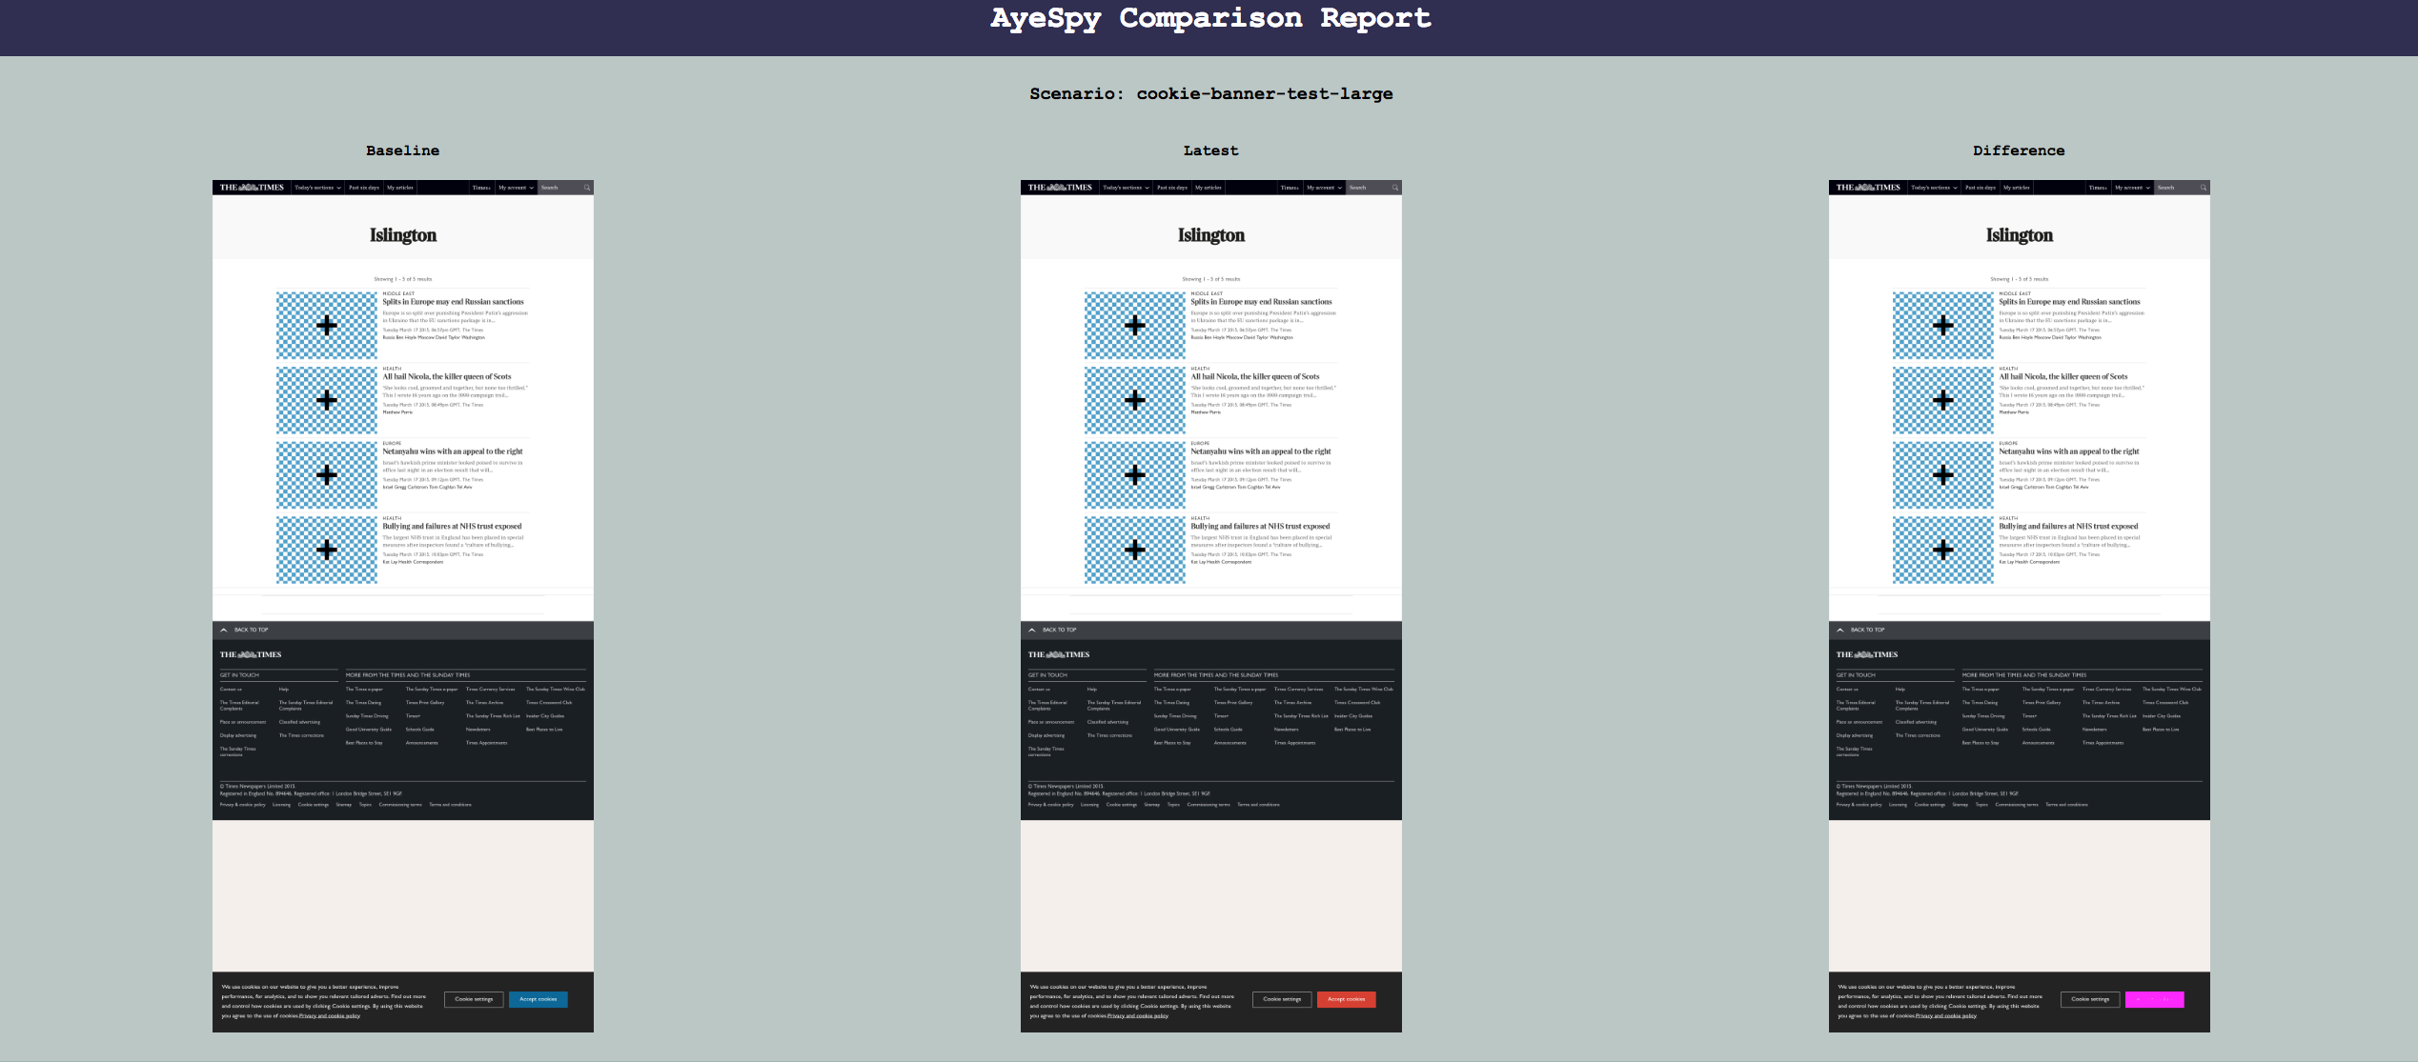
Product Owners can Assess Visual Snapshot Tests
Capture a visual snapshot of an application under a state
If that snapshot changes, produce a visual report for manual sign-off
https://github.com/newsuk/AyeSpy
Notes:
<read slide>
The screenshot here shows the report that an open-source visual regression testing tool called “AyeSpy” produces. On the left it shows the baseline, what the application looked like the last time that the snapshot was generated. Then, it shows what it looks like in the latest version. The difference on the far right highlights the changed part (the accept cookies button on the bottom changed from blue to red, and the change is highlighted in purple).
There are plenty of commercial tools that make this look much more slick, and integrate the tests with project management software, so that the product owners (who may not be developers themselves) can approve changes to the snapshots.

Slide 37
Learning Objectives for this Lesson
You should now be prepared to:
Explain why you might need a test double in your testing
Design test cases for code using fakes, mocks and spies
Explain why you might need tests that are larger than unit tests
Explain how large, deployed systems lead to additional testing challenges

